Slide 1
SAP BTP Extension Suite Training
Day 31
Anubhav Oberoy
www.AnubhavTrainings.com
Follow excellence with sheer passion

Slide 2


DISCLAIMER
The training content and delivery of this presentation is confidential, and cannot be recorded, or copied and distributed to any third party, without the written consent of Anubhav Trainings

Slide 3
Agenda – Day 31
01
Build Process Automation
02
Use Case
03
Create and Deploy process

Slide 4
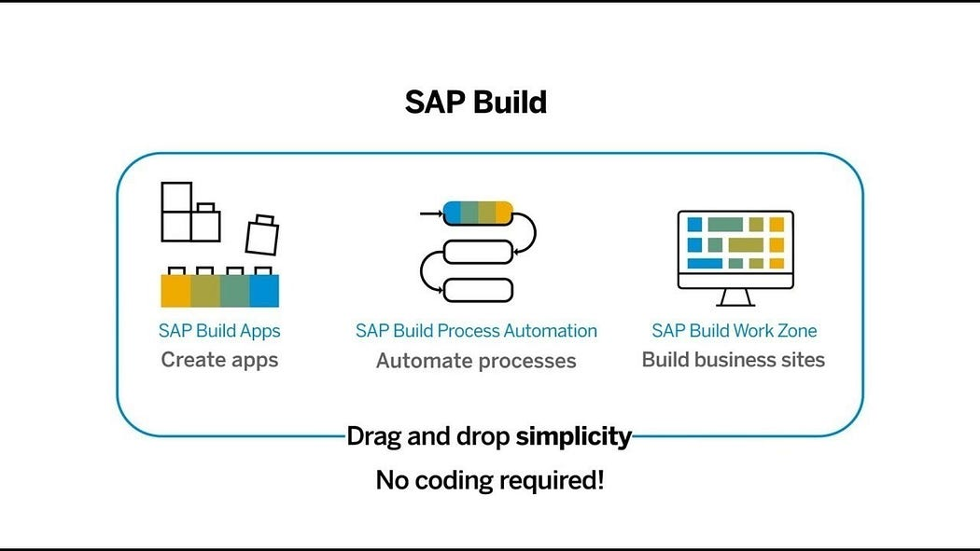
What is SAP Build?
SAP Build is a user-friendly low-code/no-code platform within the SAP Business Technology Platform (SAP BTP), designed to empower users to create, customize, and enhance applications, automate workflows, and build business sites without the need for advanced coding skills. It includes three primary components:

Slide 5
SAP Build Offerings?
SAP Build Process Automation
SAP Build WorkZone
SAP Build Apps
Purpose: Simplify the development of enterprise applications through an intuitive interface. Key Features:
Visual Development: Create UI, workflows, and logic using a drag-and-drop approach.
Prebuilt Templates: Leverage templates for common business scenarios.
Data Integration: Connect seamlessly with SAP and external systems through APIs.
Multi-Channel Deployment: Develop apps for both web and mobile platforms.
Collaboration Tools: Facilitate teamwork during the app-building process. Use Cases:
Developing HR onboarding solutions.
Building custom KPI tracking dashboards.
Creating customer-facing applications for feedback collection.
Purpose: Streamline business processes using workflows and robotic process automation (RPA). Key Features:
Workflow Automation: Manage approvals, notifications, and document routing automatically.
Prebuilt Bots: Access a library of bots to handle repetitive tasks like data entry.
Business Rules Management: Easily define and update business logic.
Process Visibility: Track and optimize workflows in real-time.
AI Integration: Utilize AI capabilities such as document recognition for enhanced automation. Use Cases:
Automating invoice approval workflows.
Managing employee leave requests.
Connecting and streamlining repetitive processes across systems.
Purpose: Design tailored business sites and portals for employees, customers, or partners. Key Features:
Prebuilt Templates: Quickly create branded portals.
Content Integration: Combine apps, dashboards, and workflows in a unified portal.
Role-Based Access: Customize content and permissions according to user roles.
Collaboration Features: Incorporate chat, forums, and knowledge-sharing tools.
Mobile-Friendly Design: Ensure accessibility across all devices. Use Cases:
Developing employee self-service platforms.
Creating customer support portals.
Building collaboration hubs for partners.

Slide 6
SAP BTP Build Process Automation
SAP Build Process Automation is a citizen developer solution to adapt, improve, and innovate business processes with no-code workflow management and robotic process automation capabilities.
SAP Build Process Automation enables business users and technologists to become citizen developers. With powerful yet intuitive low-code and no-code capabilities, the solution supports you in driving automation by tapping into the expertise of citizen developers.
Features
Build or adapt processes with an intuitive graphical interface.
Create forms-based workflows using drag-and-drop functionality.
Develop and manage decision logic in tabular, spreadsheet-like decision tables.
Automate repetitive tasks within existing process flows using robotic process automation.
Create intelligent actions and recommendations using machine learning capabilities.
Work efficiently from a unified launchpad and task center.
Hand over projects to professional developers, who can embed actions and advanced workflows into projects initiated by citizen developers.
Support real-time, event-driven transparency into comprehensive processes and process instances with process visibility dashboards.
In addition, SAP Build Process Automation offers prebuilt content and features – such as bots, process steps, business rules, and workflow components.

Slide 7
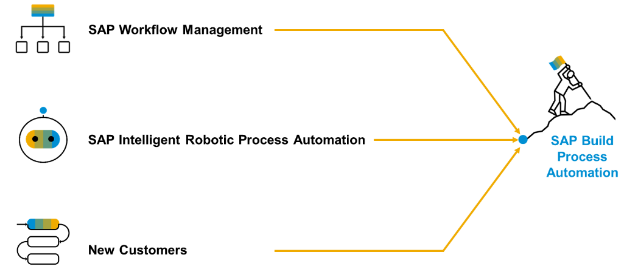
Product Overview
SAP Build Process Automation is a solution that evolved out of the former stand-alone SAP products - SAP Workflow Management and SAP Intelligent Robotic Process Automation. It provides a new citizen developer experience that didn't exist in either of the two former products.
As you or your company might have used SAP Workflow Management or SAP Intelligent Robotic Process Automation in the past, you are looking for a path into the joined solution. Fortunately, SAP Build Process Automation is fully compatible with all workflow and automation artifacts that you have created.

Slide 8

Scenario – Supplier App
🧑‍💼 Persona: Jack Dowson – Procurement Manager
Age: 34
Location: Chicago, USA
Industry: Manufacturing
Role: Manages procurement for factory suppliers
Goals:
Quickly find suppliers
Ensure availability to take orders based on size
On-board new suppliers with approvals
🎯 Objective
Design a user-friendly process that allows Alex to:
Enter product Id
Enter Supplier Id
Create approval request to procurement head
Once Approved, get notified

Slide 9























Design

Slide 10

Hands-on Create process for Alex

Slide 11
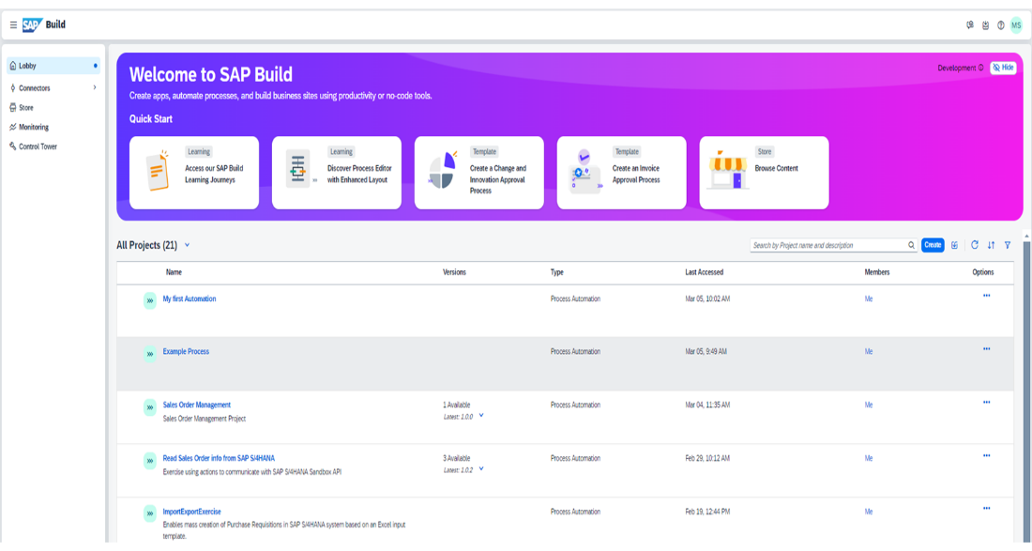
Core Components
Lobby – Centrally view and manage all build apps and business processes.
Process Builder- a LCNC design studio to design the business process and add multiple tasks
Connectors – configure connections with the systems
Store – Explore and import pre-built SAP standard process content
Monitoring – Analyze and monitor the on-going processes
Control Tower – Discover the implementation guide and configure IRPA desktop agents

Slide 12

What We Did
Let’s Summarize

Slide 13






















Slide 14

www.anubhavtrainings.com
Thank You
End of Day 20

Slide 15


We’re committed to empower you to be
#FutureReady
through powerful training solutions.
We build the workforce of the future.
260+
Corporate Clients
60,000+
Learners Trained
26000+
Learners Placed
FREE WEBINARS
Sign up for free webinars with industry experts every fortnight!
Enroll Now!
Contact us today!
https://anubhavtrainings.com

